Slide 1

Data Science Intern at Data Glacier
Week 13 Deliverables
Healthcare - Persistency of a drug
LISUM12

Slide 2
Info
Name: Mariam Ali Bashandy
Individual: Solo
Email: mariam.a.bashandy.1@gmail.com
Country: Egypt
College: German International University of Applied Science
Specialization: Data Science
Date : 19/9/2022
Batch code: LISUM12

Slide 3
Table of Contents
1- Project Plan 9- Roc Plot
2- Problem statement and business understanding 10- Flask Deployement
3- Data Collection
4- Data Understanding
4.1- Types of data
4.2- Check Missing Values
4.3- Check Outliers
4.4- Check skew for numeric
5- Data Cleaning and feature engineering
5.1- Handling outliers
5.2-Skew
5.3- Encoding
6- EDA
7- Model Building and Model Selection
8- Accuracy of Models

Slide 4
Project Lifecycle along with deadlines
Weeks | Date | Plan
Week 07 | 19/9/2022 | Problem statement, Data Collection and Data Report
Week 08 | 26/9/2022 | Data preprocessing
Week 09 | 2/10/2022 | Feature engineering and data cleaning
Week 10 | 9/10/2022 | EDA
Week 11 | 16/10/2022 | Build Model and Model Result Evaluation (EDA Presentation)
Week 12 | 23/10/2022 | Flask deployment
Week 13 | 20/10/2022 | Final submission

Slide 5
Problem statement & Business Understanding
One of the challenge for all Pharmaceutical companies is to understand the persistency of drug as per the physician prescription and ABC pharma company has the same challenge and to solve this problem wants to automate the process of identification.
Objective to gather insights on the factors that are impacting the persistency and build a classification for the given dataset to automate the process.
For Business Understanding needs:
Know drug persistency and how it calculated
Define the business problem
Define objective and criteria to solve it

Slide 6
Data Collection
The Data is about Healthcare which contain 69 number of features and 3424 number of observations and it was used to detect Persistent vs Non-Persistent
Total number of observations | 3424
Total number of files | 1
Total number of features | 69
Base Format of the file | .csv
Size of the data | 898KB

Slide 7
Data understanding
In this part, we will explain data understanding
Types of data
The dataset contains 69 features, we found 67 out of 69 data type are categorical and only two features were numerical (names of numeric: Dexa_Freq_During_RX and Count_Of_Risks)
Missing Values
No missing values found in this dataset
Outliers
We found outliers in both two numerical attributes and may have solve them by IQR or Simple Imputer in the next step.
Skew
We found that both numeric have skew greater than zero so will own more weight in the left

Slide 8
Data Cleaning and feature engineering
In this part, we will explain data cleaning and feature engineering
Handling Outliers
We removed outliers by two ways which are Z-score and IQR and they did will and remove outliers and the one that choose from both wad IQR since when done handling outliers by it doesn’t remove too much data, we didn’t do this to categorical after doing encoding since this would results in large loss of data.
Skew
We solved the problem by using Power Transformer and it distribute the data.
Encoding
We encode the categorical attributes to not led to problem in ML part.

Slide 9
EDA
In this part, we will explain EDA
The columns Risk_Type_1_Insulin_Dependent_Diabetes, Risk_Osteogenesis_Imperfecta, Risk_Rheumatoid_Arthritis, Risk_Untreated_Chronic_Hyperthyroidism, Risk_Untreated_Chronic_Hypogonadism, Risk_Untreated_Early_Menopause, Risk_Patient_Parent_Fractured_Their_Hip ,Risk_Smoking_Tobacco, Risk_Chronic_Malnutrition_Or_Malabsorption, Risk_Chronic_Liver_Disease, Risk_Family_History_Of_Osteoporosis ,Risk_Low_Calcium_Intake, Risk_Vitamin_D_Insufficiency, Risk_Poor_Health_Frailty, Risk_Excessive_Thinness, Risk_Hysterectomy_Oophorectomy, Risk_Estrogen_Deficiency, Risk_Immobilization Risk_Recurring_Falls
So will be reduced due to Count_of_Risks includes summation of them, reached to 50 by that and also in cleaning phase we drop patient ID
The Columns
Comorb_Encounter_For_Screening_For_Malignant_Neoplasms,Comorb_Encounter_For_Immunization,Comorb_Encntr_For_General_Exam_W_O_Complaint,_Susp_Or_Reprtd_Dx,Comorb_Vitamin_D_Deficiency,Comorb_Other_Joint_Disorder_Not_Elsewhere_Classified',Comorb_Encntr_For_Oth_Sp_Exam_W_O_Complaint_Suspected_Or_Reprtd_Dx,Comorb_Long_Term_Current_Drug_Therapy,Comorb_Dorsalgia,Comorb_Personal_History_Of_Other_Diseases_And_Conditions,Comorb_Other_Disorders_Of_Bone_Density_And_Structure,Comorb_Disorders_of_lipoprotein_metabolism_and_other_lipidemias,Comorb_Osteoporosis_without_current_pathological_fracture,Comorb_Personal_history_of_malignant_neoplasm,Comorb_Gastro_esophageal_reflux_disease,Concom_Cholesterol_And_Triglyceride_Regulating_Preparations,Concom_Narcotics,Concom_Systemic_Corticosteroids_Plain,Concom_Anti_Depressants_And_Mood_Stabilisers,Concom_Fluoroquinolones, Concom_Cephalosporins,Concom_Macrolides_And_Similar_Types,Concom_Broad_Spectrum_Penicillins, Concom_Anaesthetics_General,Concom_Viral_Vaccines
Will be two columns have count of them one for columns that start with comorb and one for concom and reached 28 features only

Slide 10
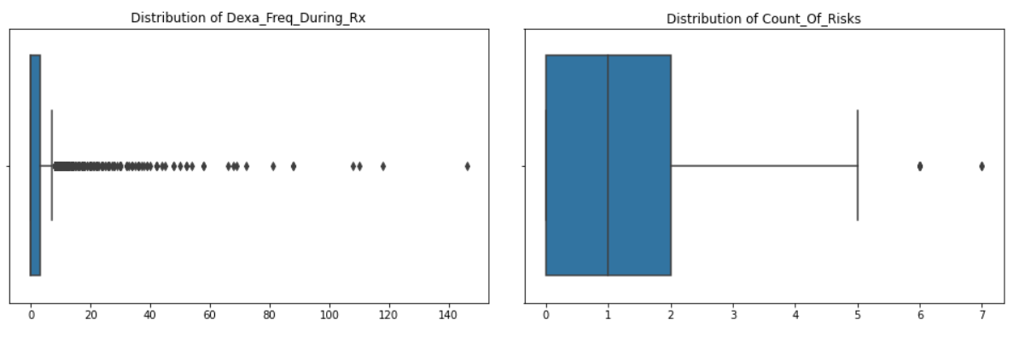
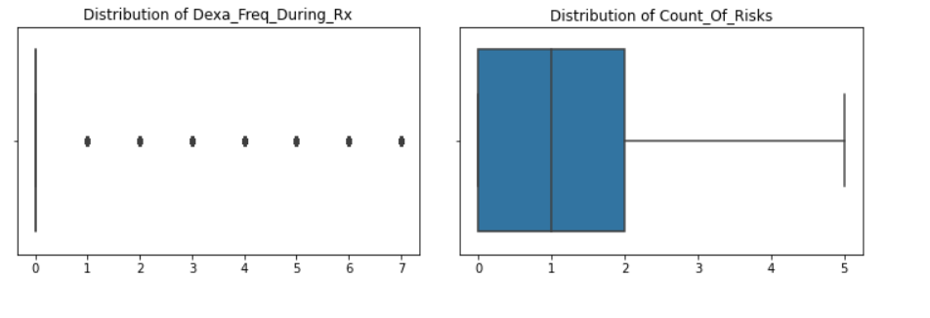
EDA
Handling outliers the first graph was before handling and the second one after handling outliers in numeric attributes

Slide 11
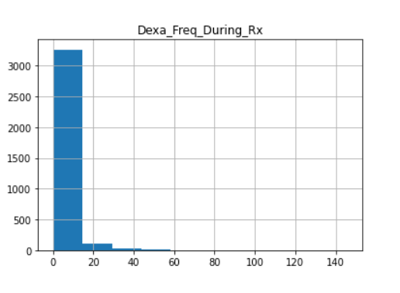
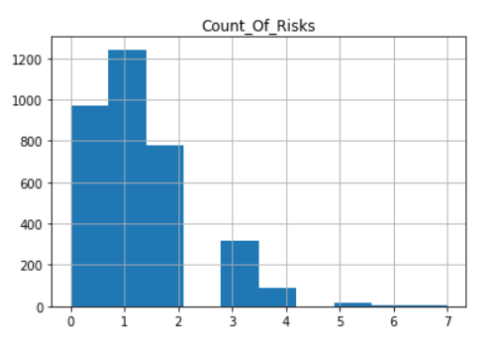
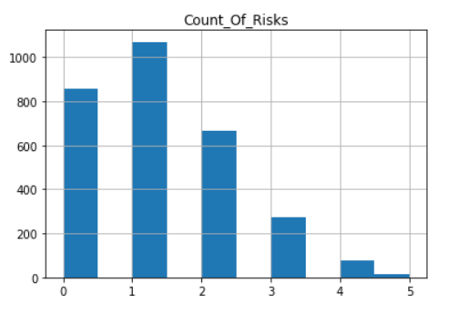
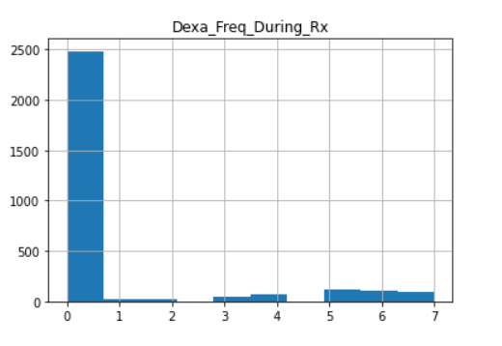
EDA
Skew graph before doing transformation
Skew graph after doing transformation

Slide 12
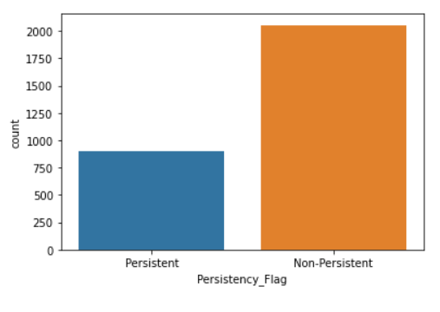
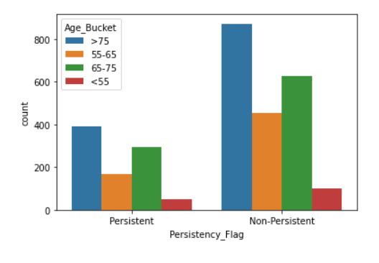
EDA
Non-Persistent for drug is higher in our data
The age_Bucker >75 in Persistent and non-Persistent have higher value so they people greater than 75 have higher chance to persistent by drug

Slide 13
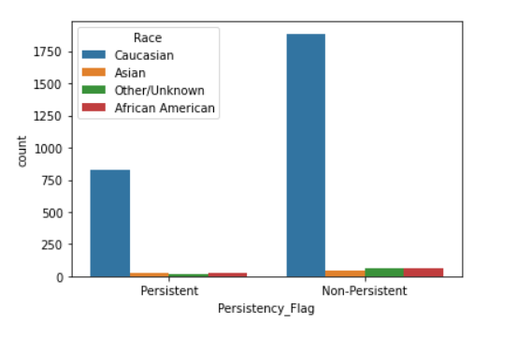
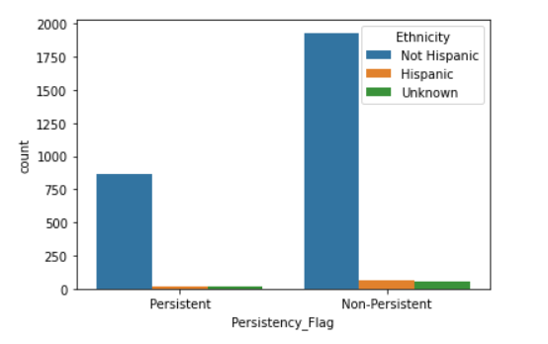
EDA
The Caucasian Race in both persistent and have highest count
The Caucasian Race in both persistent and non-Persistent have highest count
Not Hispanic is dominant in Persistency Flag of drugs

Slide 14
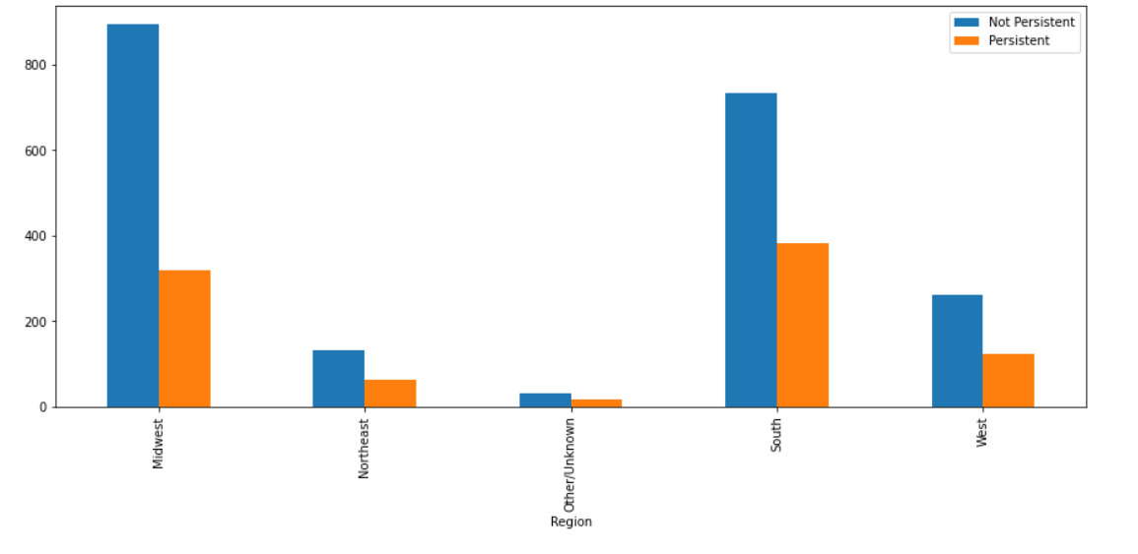
EDA
In all the regions the dominant was Not-Persistent
The Midwest was higher region to not persistent from drug than South

Slide 15
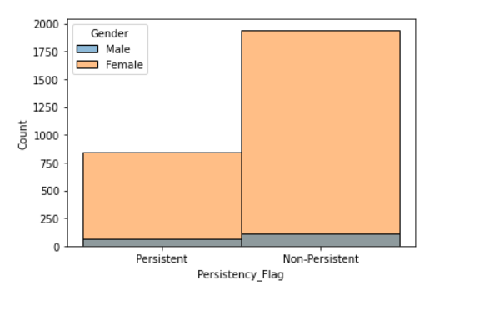
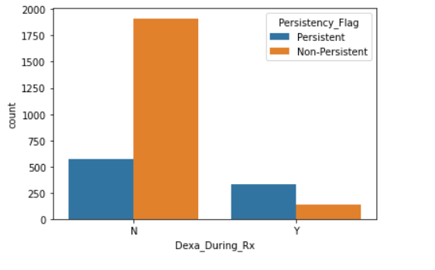
EDA
Female patients are more persistent of a drug than male
The number of patients without having Dexa scan is higher to be non persistent by drugs

Slide 16
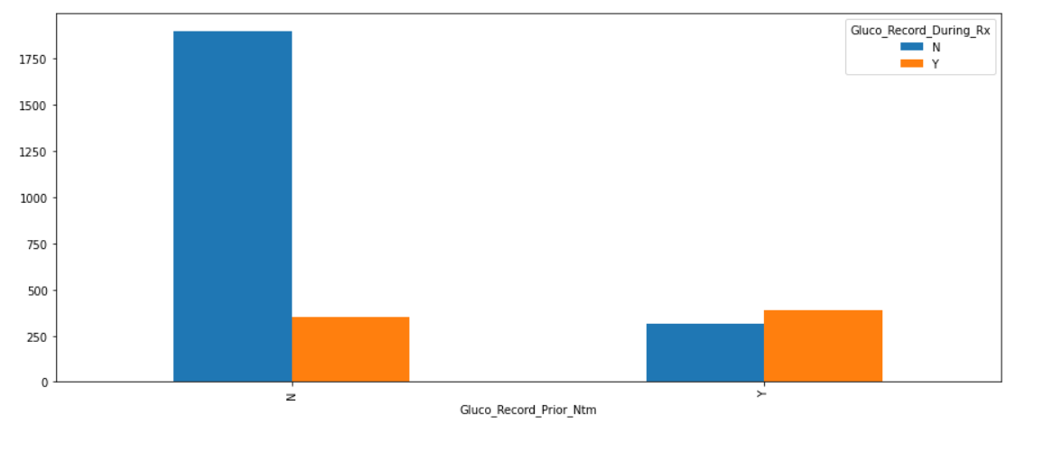
EDA
The ratio of the patients which are stable is much more higher than of the ratio of the improved patients

Slide 17
Preparation for Model building and Model Selection
We split data into train and test
Start preparing for model selection
Choose models: Random forest, Logistic Regression, Support Vector machine , KNN , Neural network , decision tree and Gradient Boost Model
The best model Gradient Boost Model was since have the highest accuracy by 79.05 which was near to the accuracy of logistic Regression

Slide 18
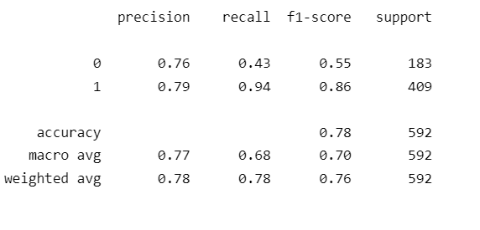
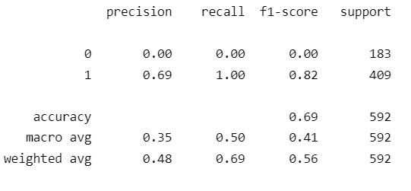
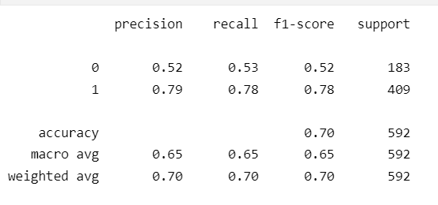
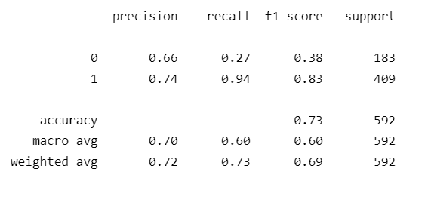
Accuracy
The report of every model and the selection one
Logistic Regression
Support Vector Machine
Decision tree
KNN

Slide 19
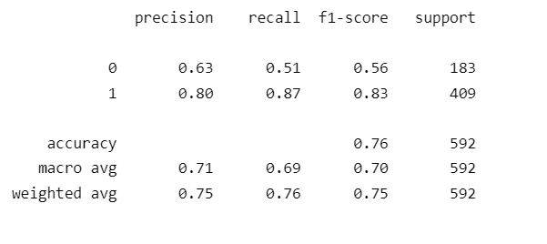
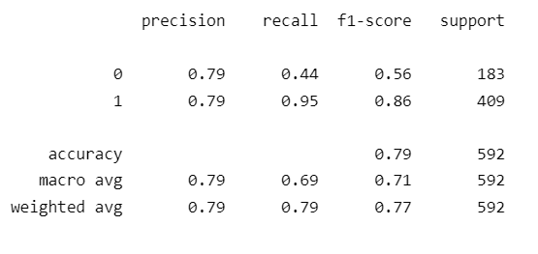
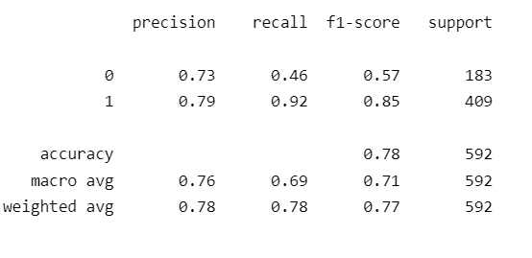
Accuracy
Rest
Neural Network
Gradient Boosting Model
Random Forest Classifier
With the result of accuracies the best Model was Gaussian Boosting Model

Slide 20
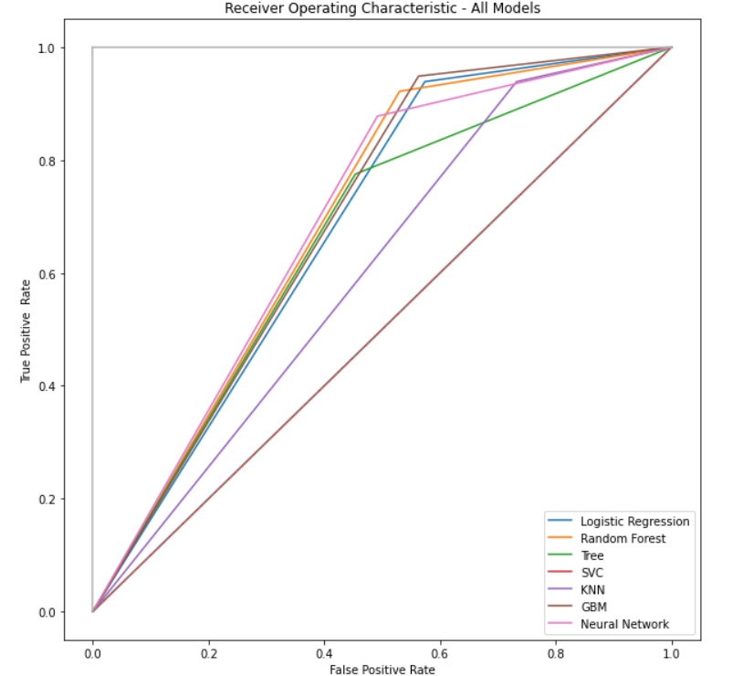
ROC Plot
The best model Gradient Boost Model was since have the highest accuracy by 79.05 which was near to the accuracy of logistic Regression

Slide 21
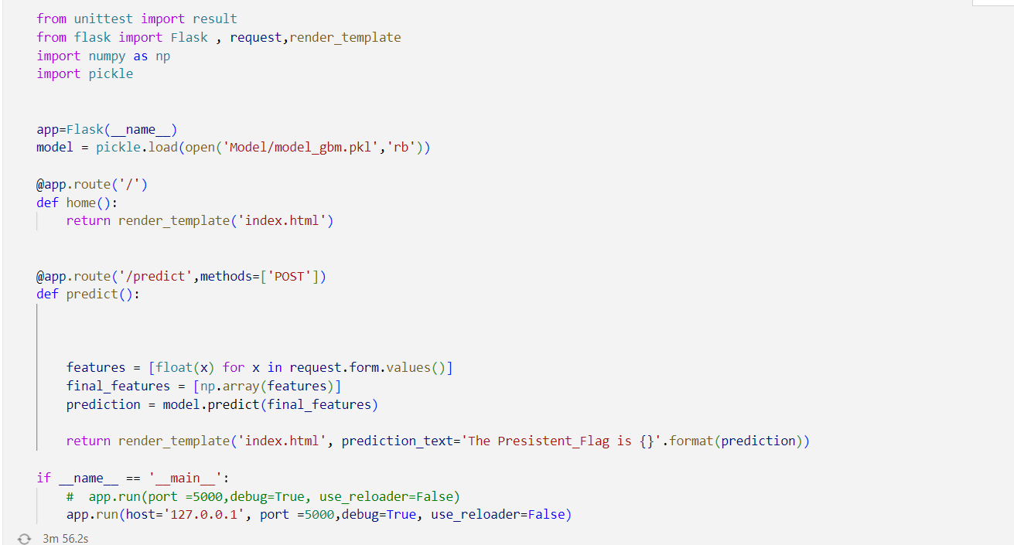
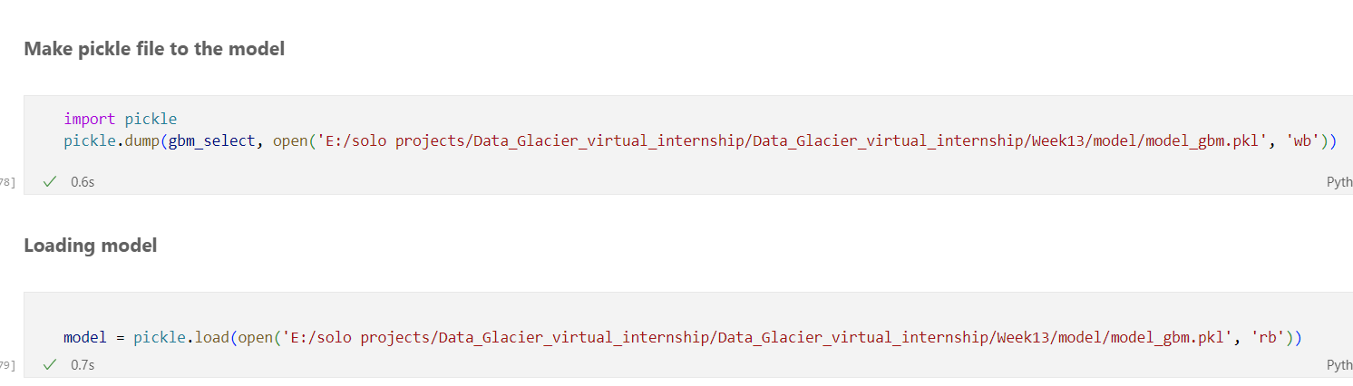

Flask Deployment
We created the model.pkl file and html and style.css for styling the form of app
Then we create the app at port 5000
The attachment screenshots for code of flask deployment and the last screenshot was when predict the value of
persistently _Flag

Slide 22
GitHub link
https://github.com/Mariamali2001/Data_Glacier_virtual_internship

Slide 23
Thank You

